Slide 1

Rosemount Rex 3900-series
Radar Tank Gauge

Slide 2
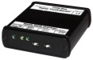
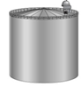
Rex 3900-series
3rd generation of land based Tank Gauging
±0,5 mm instrument accuracy
10 GHz FMCW
Custody Transfer approved
SIL 2 certified
4 wire
2 bus, 2 power

Slide 3
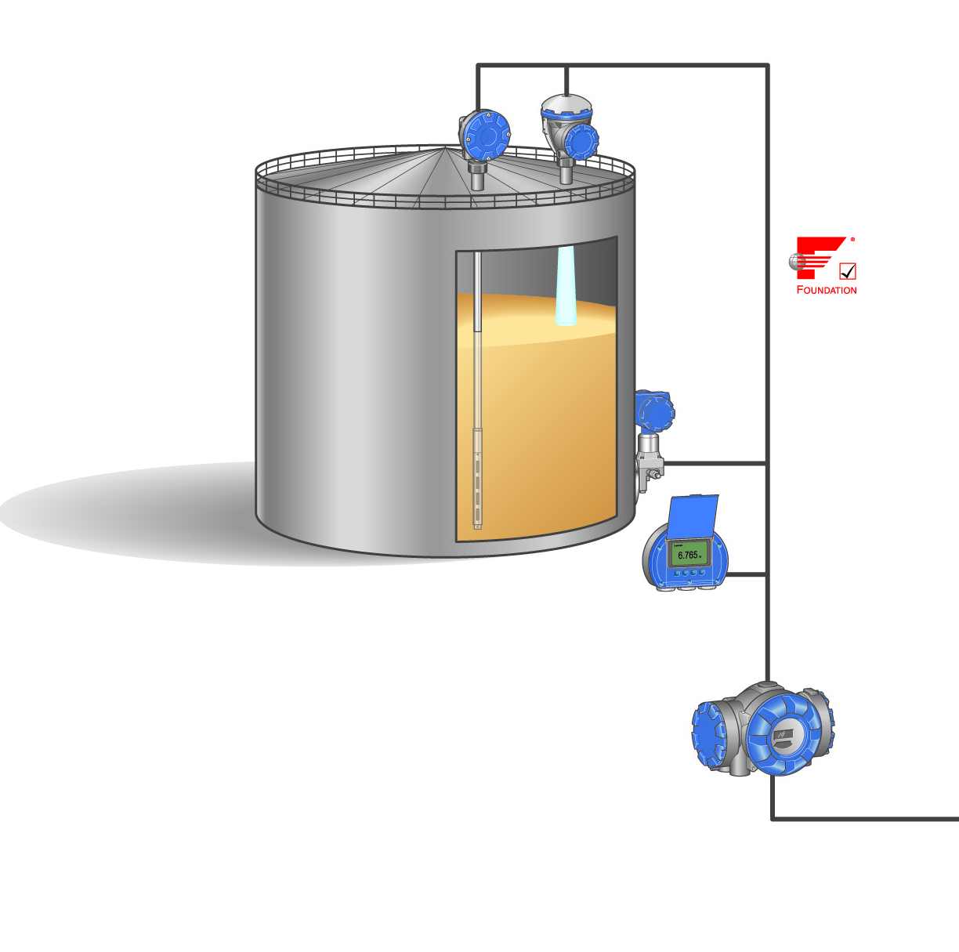
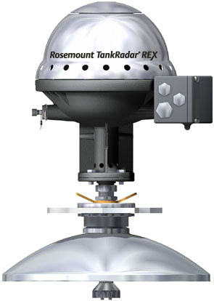
Rex Specifications
Instrument accuracy
±0.5 mm (0.020 in.)
Ambient Operating Temperature -40 to +70 °C (-40 to +158 °F)
Notes:
Updaterate 3Hz, i.e. 3-4 measurements per sek.
Tank hub collects data from 5900S 1 time/sec

Slide 4
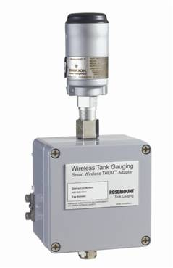
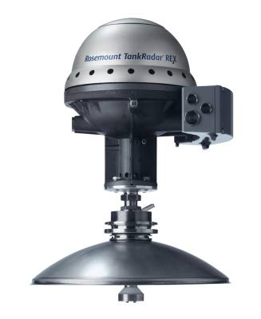
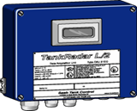
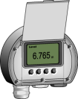
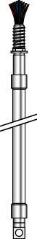
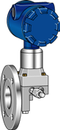
Rex Inputs and Outputs
SDAU
RDU
THUM
2 X Relay
4-20 mA
Communication bus
Rosemount TRL/2
RS-485 Modbus
Foundation Fieldbus
Profibus DP
Emulation
Enraf
Sakura
L&J
Varec
Whessoe
Tiway
GPE
GSI
Temp
sensors
maximum
14 spots
PT 100
Temp
sensor
maximum
6 spots
PT 100
Pressure
Sensor
4-20 mA
Input
or
3 x HART
Water bottom
sensor
4-20 mA Input
Notes:
No SDAU if RDU40.
No RDU40 if SDAU.
No RDU40 if Wireless.

Slide 5
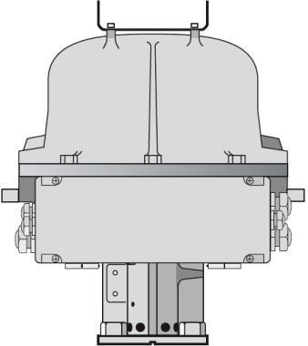
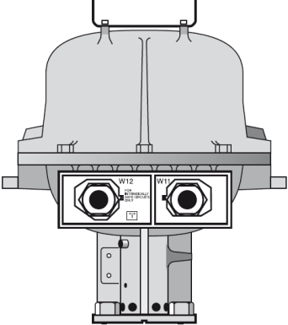
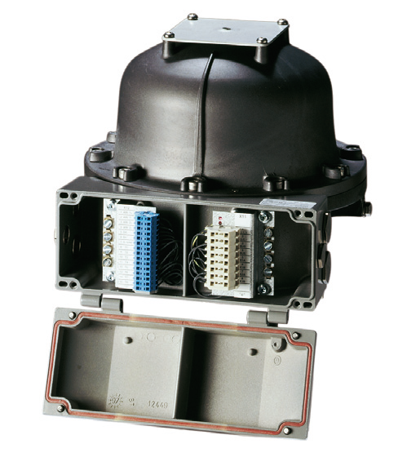
Rex Installation Considerations
With JBi* | Without Jbi*
Two connection terminals: | Two separate outlets:
- One for power, field bus and relays | For power and field bus: 8 wires, 2.5m/8ft (optional cable length 20m/50ft)
- One for IS connections from temperature, pressure | - For IS connections: 8 or 15 wires, 2.5m (8ft) (optional cable length 20m/50ft)
* Jbi = Integrated Juction Box for cable connections

Slide 6
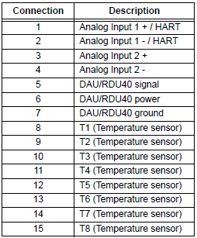
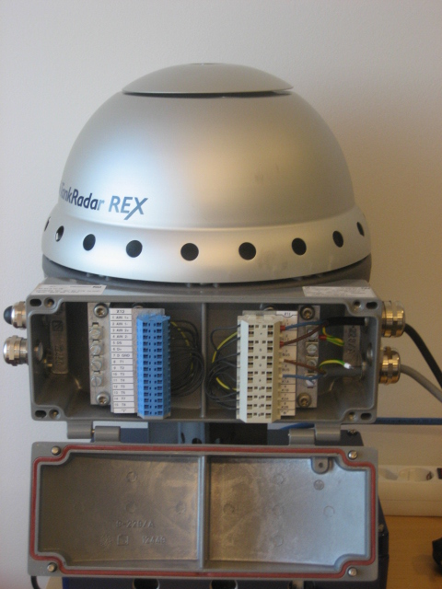
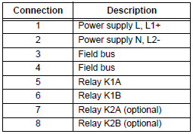
Terminal Block
Clearly marked cables
Integrated junction box sockets for
Intrinsic connections (X12)
Non-intrinsic connections (X11)
X12 Eex i
X11 Eex i

Slide 7
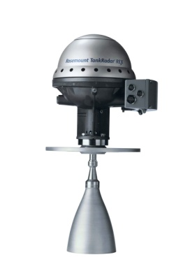
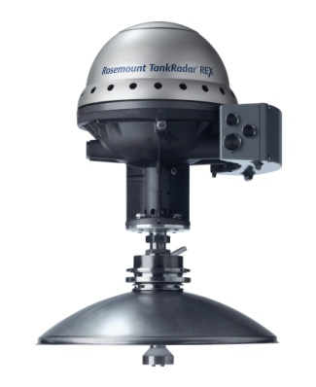
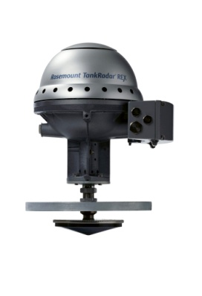
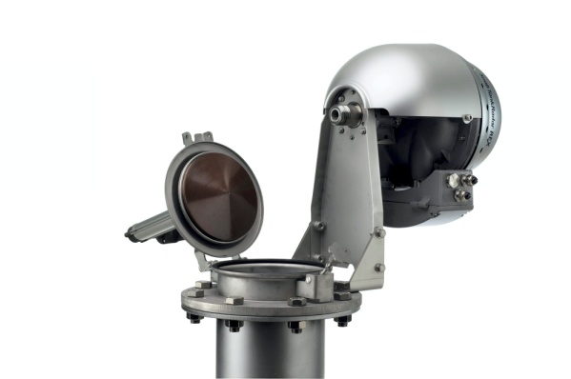
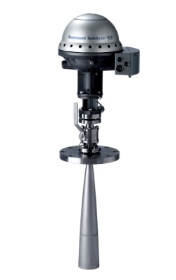
Rex Antennas
3920 Horn Antenna | 3930 Parabolic Antenna
3950 Array Antenna | 3960 LPG Antenna

Slide 8
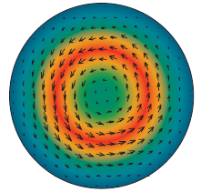
Rex 3950 Still-pipe Array Antenna
Designed for:
5”, 6”, 8”, 10” and 12” still-pipes
Typical applications
Crude oil tanks with floating roofs
Gasoline/product tanks with or without inner floating roofs
Drip-off design
Low loss mode technology
No affect of rust and deposits in pipe
Rosemount Patent

Slide 9
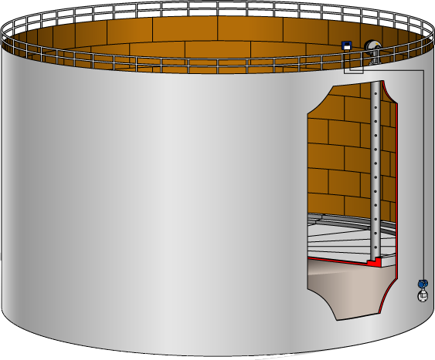
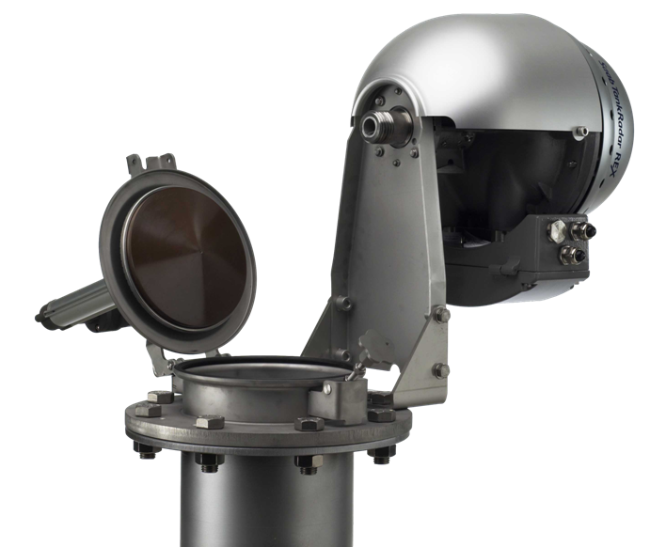
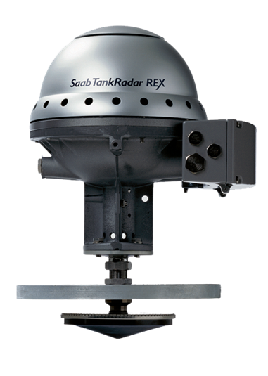
Rex 3950 Still-pipe Array Antenna
Fixed version
Inclined version
Enables hand dip
Notes:
Different from 5900S

Slide 10
Rex 3950 Still-pipe Array Antenna
Measuring range
0.8 to 40 m (2.6 to 130 ft) from end antenna
For longer measuring range, consult Rosemount repr.
Pressure range
Fixed version: -0.2 to 2 bar (-2.9 to 29 psig) at 20°C
Inclined version: 5” to 8” pipes, -0.2 to 0.5 bar (-2.9 to 7.2 psig). 10” and 12” pipes, -0.2 to 0.25 bar (-2.9 to 3.6 psig)

Slide 11
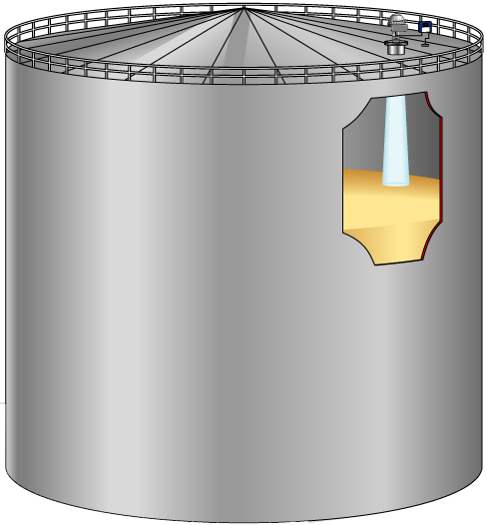

Rex 3930 Parabolic Antenna
Designed for
Fixed roof tanks
Works on floating roofs too
18-inch manways or larger
Custody transfer accuracy
Measures on all types of liquids
Bitumen and Asphalt
Sticky and condensing products

Slide 12
Rex 3930 Parabolic Antenna
Measuring range
0.8 to 40 m (2.6 to 100 ft) OIML range
0.5 to 50 (1.6 to 164 ft), possible.
Pressure range
Clamped -0,2 to 0,2 bar (-2,9 to 2,9 psig)
Welded -0,2 to 10 bar (-2,9 to 145 psig)
Narrow beam
Suitable in narrow tanks with internal structures
THE BEST ANTENNA FOR FREE PROPAGATION

Slide 13
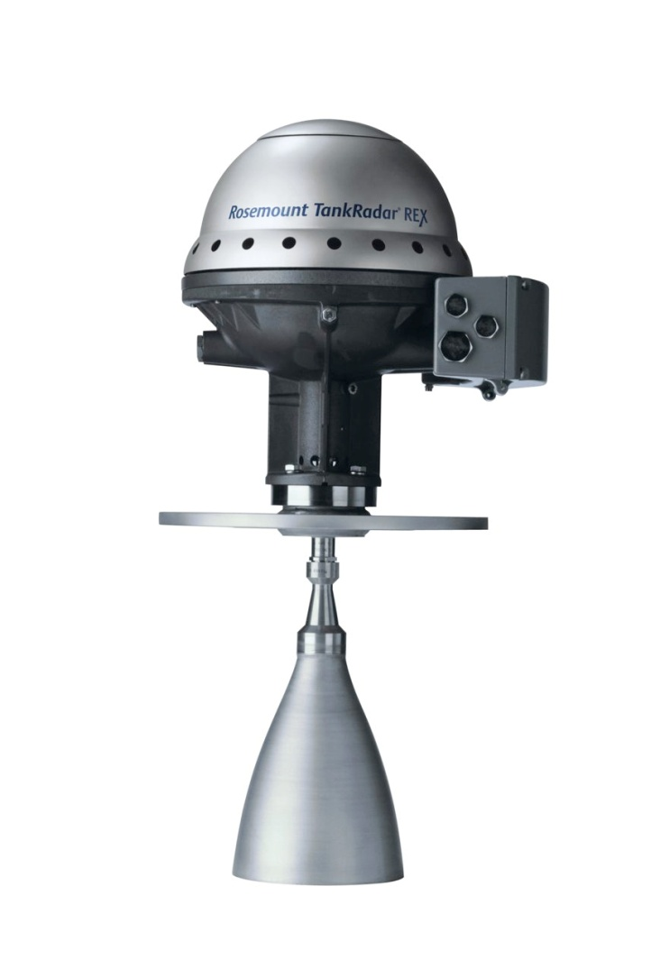
Rex 3920 Horn Antenna
Designed for
8 -17 inch nozzles
Fixed roof tanks
Works on a variety of oil products and chemicals
Flange
Horizontal flange
4° inclined flange

Slide 14
Rex 3920 Horn Antenna
Measuring range
0.8 to 20 m (2.6 to 65 ft) standard
0.3 to 30 m (1 to >100 ft) possible.
Pressure range
-0.2 to 2 bar (-2.9 to 29 psig)

Slide 15

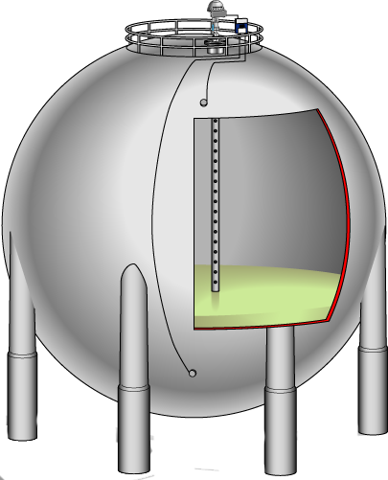
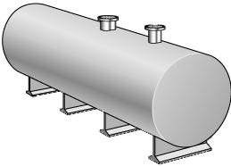
Rex 3960 LPG/LNG Antenna
LPG and LNG gauge for Bullets and Spheres
Pressure up to 25 bars
Measuring range up to 60m
4” or DN 100 still pipe
Only cone antenna inside tank
Vapor influence compensation (with vapor Pressure sensor)
Reference pin makes verification possible during normal operation.
Deflection plate with reflection ring at end of still pipe.
Notes:
Different from 5900S

Slide 16
Rex 3960 LPG/LNG Antenna
Measuring range
0.5 to 60 m (1.6 to 200 ft) standard
Pressure rating
10 bar, 150 psi
20 bar, 300 psi
40 bar, 600 psi
Flange
6-in. 150 psi
6-in. 300 psi
6-in. 600 psi

Slide 17
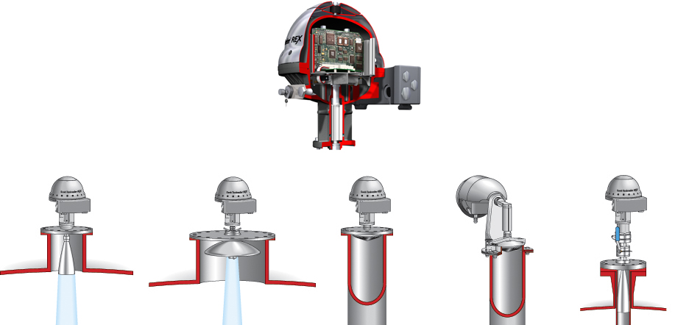
REX Transmitter Head
One head for all antennas
Notes:
There are five types of gauges to fit to any storage tank. Gauges are built up by the TH and antenna. The same TH is used on all gauges. This is to minimize amount of spare parts. It is freely interchangeable between different gauges regardless of antenna type.
The THE inside the TH includes the microwave unit, circuit boards, data communication, power supply and transient protection.

Slide 18
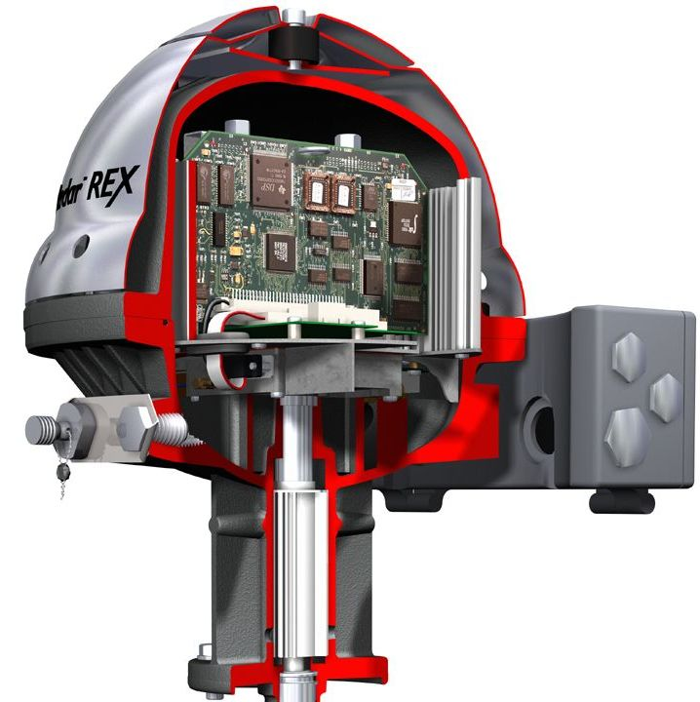
Hardware - Overview
Weather protection
Cover
Junction box cover
Cable entrance

Slide 19
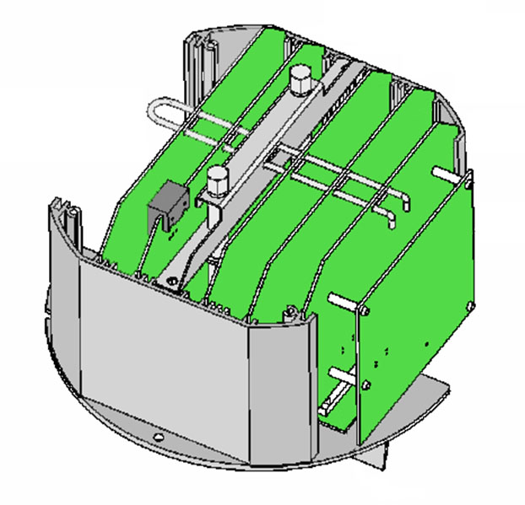
Transmitter Head
REX Electronic Boards
MB = Mother Board
TRC = Transformer Rectifier Card
FCC = Field Communication Card
SPC = Signal Processing Card
APC = Analogue Processing Card
TIC = Transmitter Interface Card
TMC = Temperature Multiplexer Card
TRC
FCC
SPC
APC
TIC
TMC
MB
Notes:
Större text i bilden

Slide 20
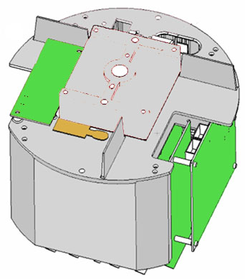
Transmitter Head
ROC
MWM
View of REX THE (as seen from below):
ROC = Relay Output Card.
MWM = Microwave Module
Heating element
Notes:
Större text i bilden
Pil till tempelementet

Slide 21
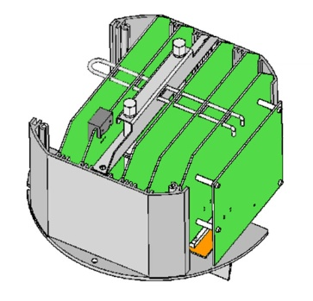
MB = Mother Board
Used as a passive power and signal carrier to the various daughter boards.
Contains mains fuse (1.6 A) and mains filtering and over-voltage protection
Equipped with an I²C bus used for automatic hardware detection.
Support for a metrological seal switch
Holds an extra two pin connector for features as Analogue output, L&J, Whessoe, Varec, Profibus
Notes:
Ta bort text runt bilden
Större bild?
Bild på själva kortet

Slide 22
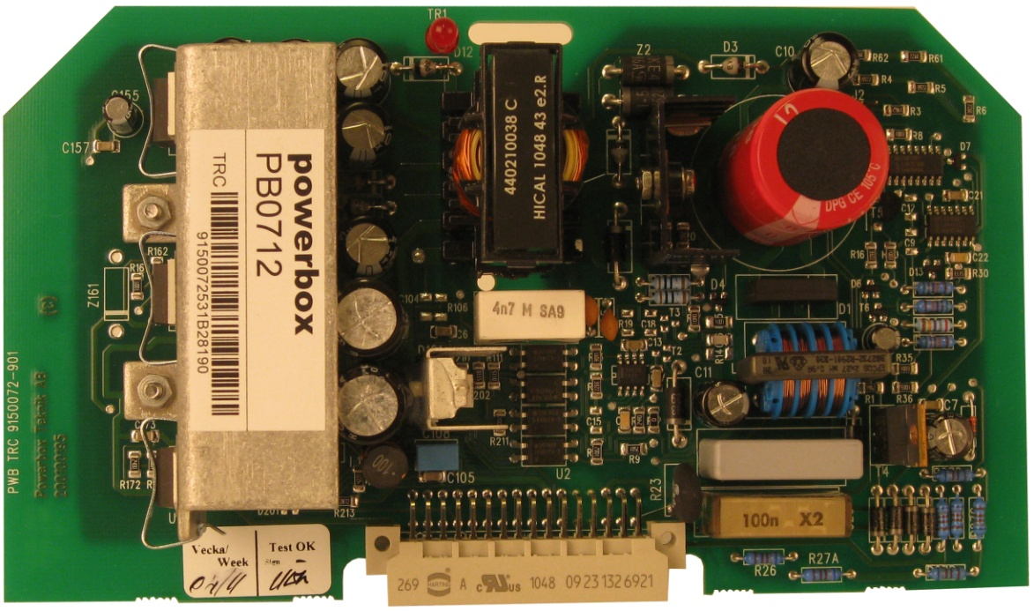
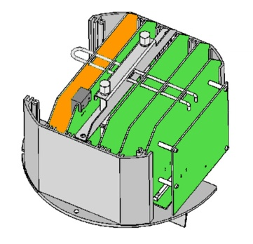
TRC = Transformer Rectifier Card
Switched power supply (primary side)
Standard: AC mains voltages (nominal 100-240 VAC, 80 W) without any manual changing over/switching
Alternative low voltage AC/DC, 34-70 VAC, 48-100 VDC
24 VDC version
Generates 4 voltages (+5, +/-12, and +30 V)
Keeps THE at 40°C via an internal heating element. NB! Not relevant for 24VDC version

Slide 23
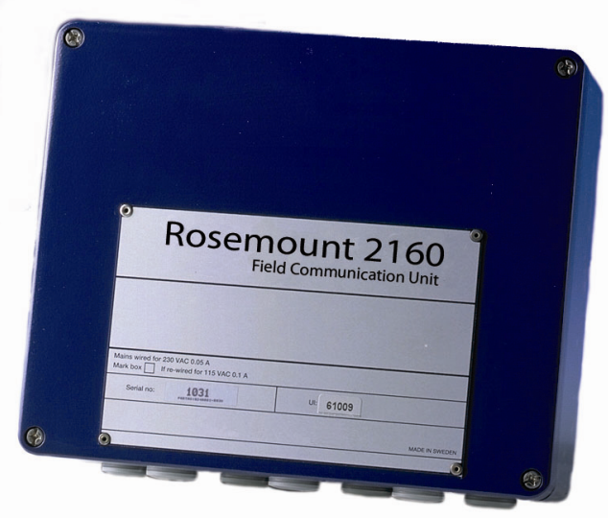
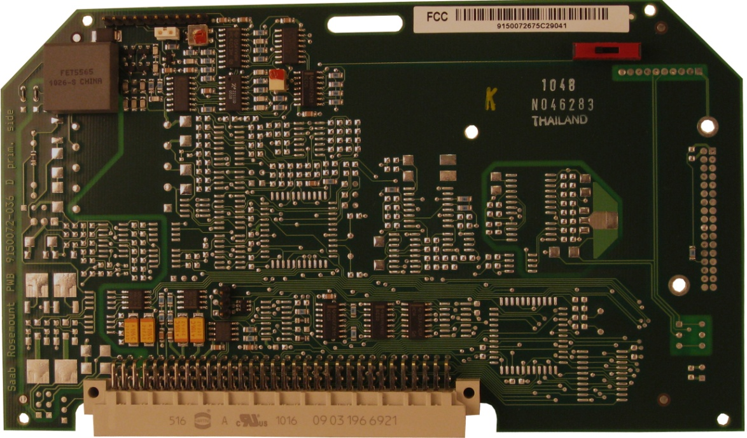
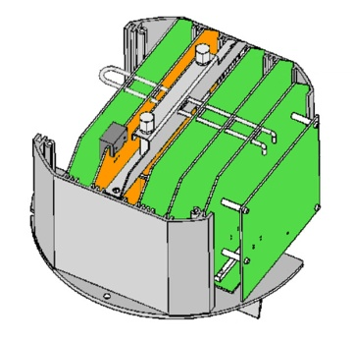
FCC = Field Communication Card
Controls communication with external devices
Emulation protocols
Standard version (-675)
TRL/2 field bus interface
Interface to SDAU or RDU 40
Note:
Early versions had a jumper for controlling communication to SDAU or RDU40
Later version is controlled via Holding Register
FCU, Mini Receiver, and other…

Slide 24
FCC = Field Communication Card
Multi-FCC, (-673)
TRL/2 Field bus interface.
SDAU / RDU 40 interface.
Internal Metrological Seal.
Hart Interface (Input).
Analogue output (Non Ex).
Enraf devices (GPU Bus).
L&J devices (TankWay Bus).
Profibus DP
Whessoe devices
Tiway Emulation
Sakura Emulation
FCC-3, (-771)
TRL/2 Field bus interface.
SDAU / RDU 40 interface.
Internal Meteorological seal.
Varec interface (Mark/Space Bus).
RS 485 communication.

Slide 25
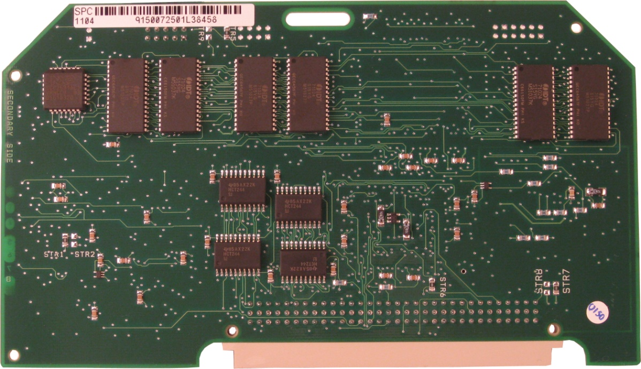
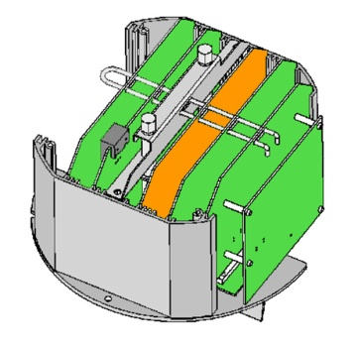
SPC = Signal Processing Card
Processor card for advanced signal processing and handling of auxiliary functions
Dual processor design, 32-bit floating point
DSP – Digital Signal Processor
COP - Communication Processor
Software stored in EEPROM
Exchangeable
Programmable via TRL/2 bus
Database a.k.a the Holding Registers

Slide 26
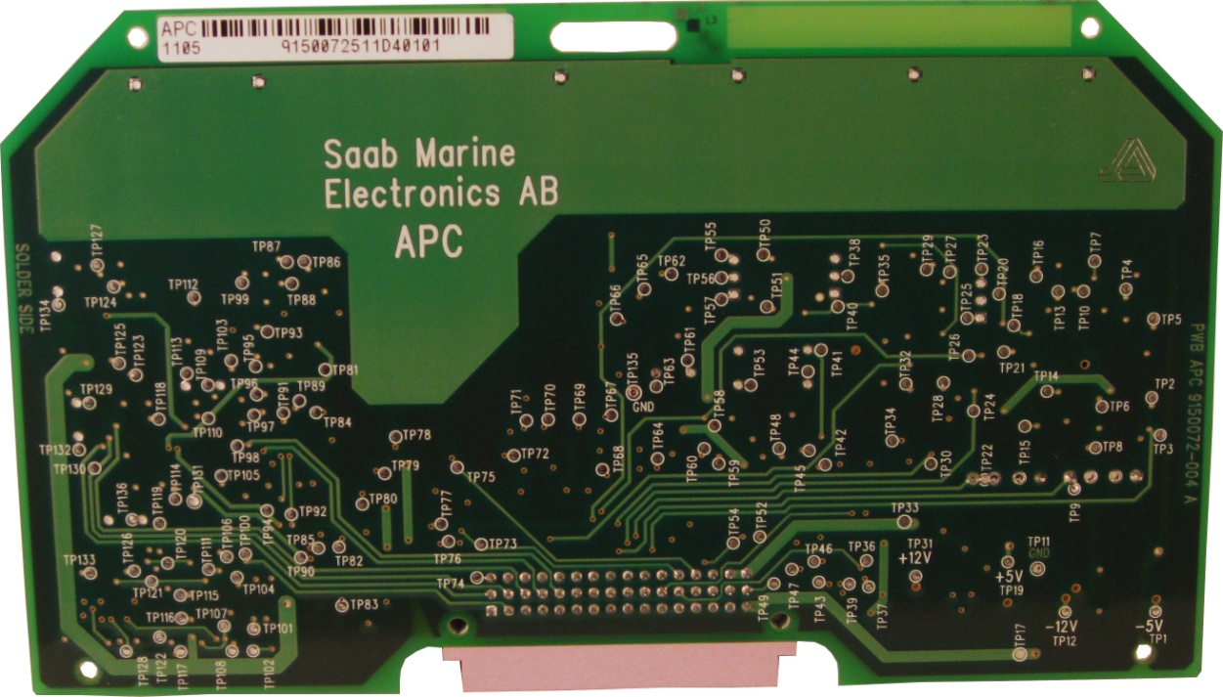
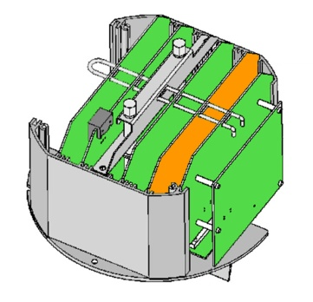
APC = Analog Signal Processing Card
For analog signal generation, multiplexing and filtering
HW-support for FMCW-sweep (MWM)
IF-Amplifier (for tank signal)
Multiplexer for sensor signals
Precision voltage references
Regulator for heating element

Slide 27
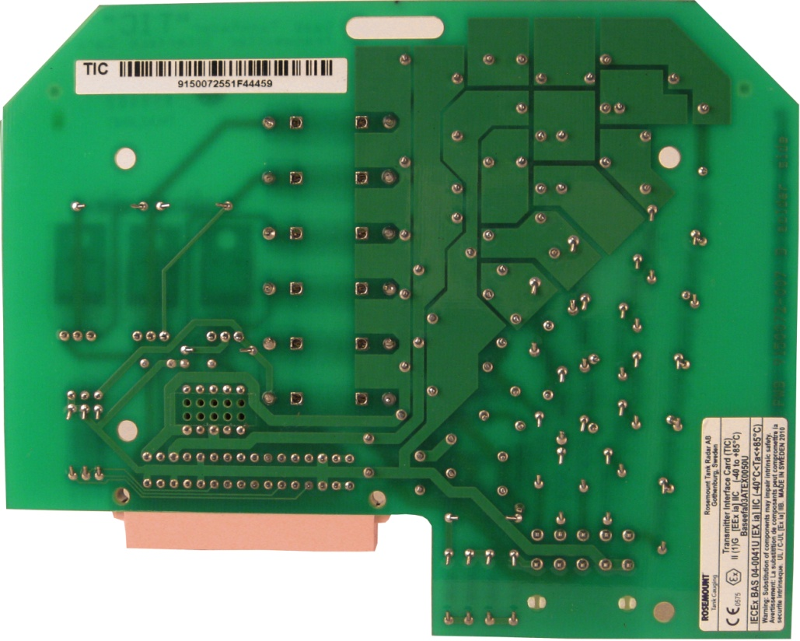
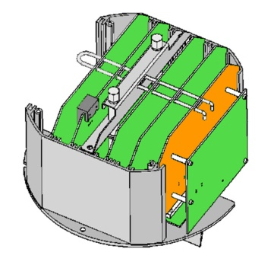
TIC = Transmitter Interface Card
Optional Board for intrinsically safe connections
Zener barriers:
Two for 4-20 mA current loop, one with HART input
One SDAU / RDU40
Signal / supply connection to the optional TMC card

Slide 28
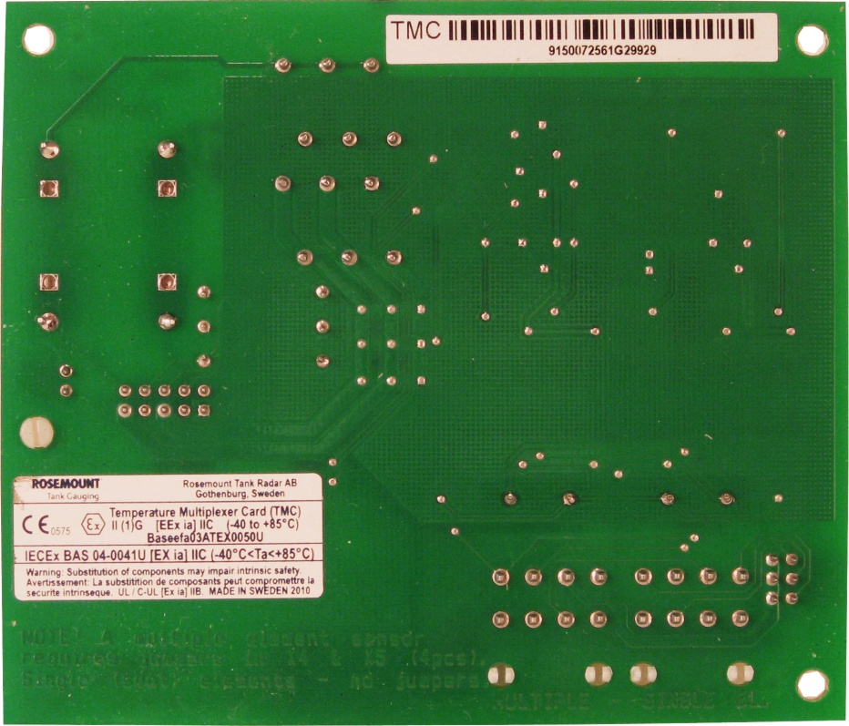
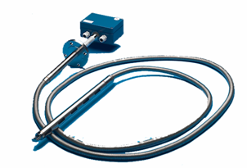
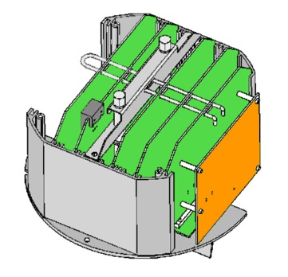
TMC = Temperature Multiplexer Card
Optional Board
“Add-on board” mounted on the back of TIC
Temperature multiplexer
Alternative connection and jumper settings
6 Spots, Multiple sensors (common return)
Jumpers in place and connector to X2
3 Spots, Spot sensors (3 wire independent)
No jumpers and connector to X3
The accuracy and temperature stability are insured by two front-end precision reference resistors.

Slide 29
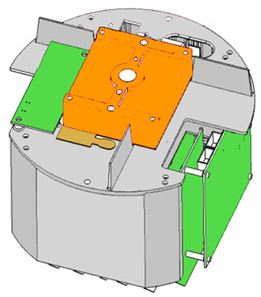
MWM – MicroWave Module
Microwave module
Transmitting and receiving radar signal.
Kept at 40°C by heating element to maintain healthy component temperature and measurement stability (80 W)
Disconnected heating <30 W

Slide 30
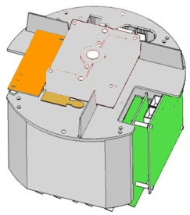

ROC - Relay output card
Optional Board
Two Relay contacts
Contact rating 250 V, 4A
Contact Life > 100 000 operations
The Normally Open (NO) and Normally Closed (NC) markings on the PCB ROC refers to the contact position of the relays when not energised
The relays will be energized when not in alarm mode (i.e. normal operation)
NOTE
Cabling for Second relay can be used for additional bus

Slide 31

Configuration
Configuration tools
TankMaster WinSetup

Slide 32




Basic Configuration
RTG Configuration
Antenna type, (pipe ID, temperature, analog in, relays)
Tank Distances
Tank Ref height
Rex Ref distance
Tank Geometry
hold off distance, calibration distance

Slide 33


Basic Configuration
Gauge Ref. Point
Tank Ref. Point
Gauge Ref. Distance (G)
Holf Off Distance
Tank Ullage
Ullage
Tank Ref. Height (R)
Measuring Range
Level
Zero Level (Dipping Datum Point)
Min. Level Offset (C)

Slide 34


Holding & Input Reg
Holding Register
Stores various parameters, configuration data
Edit by typing in new value or change separate bits(bitfield)
Input Register
Stores transmitter data

Slide 35

Diagnostics
Pre-defined selection of database registers for an instant view of the device status
Read only
Loaded from the device as the window is opened
Grey background if more information (Bitfield or ENUM)
Hexadecimal possible
Configure button
Change the list of registers to be displayed
Possible to log registers

Slide 36


Default Load
View Holding Register
All (advanced)
65510
Read data
Reset to factory settings
Click the Apply button

